Slide 1
Decision Trees and Boosting for Classification and Regression

Slide 2
Boosting for Regresion Trees
Boosting works in a way similar to bagging, except that the trees are grown sequentially:
Each tree is grown using information from previously grown trees.
2. Boosting does not involve bootstrap sampling; instead each tree is ﬁt on a modiﬁed version of the original data set

Slide 3
Boosting
Boosting for Regresion Trees
Each of these trees can be rather small, with just a few terminal nodes, determined by the parameter d in the algorithm. By ﬁtting small trees to the residuals, we slowly improve ˆ f in areas where it does not perform well. The shrinkage parameter λ slows the process down even further, allowing more and diﬀerent shaped trees to attack the residuals.

Slide 4
Boosting
In bagging, we assume that the base models will always give good results. But what if some of the data points are incorrectly classified? Combining such predictions will provide better results?
Such scenarios are taken care of by boosting.
Boosting is an iterative and sequential approach. It adaptively changes the distribution of training data after each iteration. Initially, all the data points are considered equally likely for random sampling. The model M1 is trained on the randomly sampled subset and errors are calculated. In the next iteration for incorrectly classified points, the probability of randomly selecting sampling will change from correctly classified points. The incorrectly classified points will be given more probability. So the model M2 will try to correct the mistakes made by the model M1.

Slide 5
Boosting
Therefore, the succeeding model is dependent on previous model results.
In boosting all the base learners are weak and high bias models. It combines a number of weak learners to form a strong learner. Thus each weak learner boosts the performance of the ensemble.

Slide 6
Boosting
AdaBoost is a popular ensemble technique based on boosting. Like boosting AdaBoost assigns a weight to each training examples, which determines the probability of each example appearing in training set. After training a model, AdaBoost increases the weight of misclassified points thereby giving more probability to appear them in next classifier and hopefully the next model performs well on that.
After each classifier is trained, the weights are assigned to each classifier based on their accuracy.
So the equation for the final classifier is:

Slide 7

Boosting
So the equation for the final classifier is:
Hence the final classifier is just a linear combination of weak learners.

Slide 8
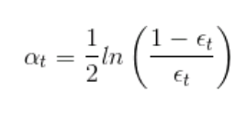
Boosting
After training the first base model we calculate the weight (α) for that model as:
Where ∈t = No. of misclassification over that training set

Slide 9
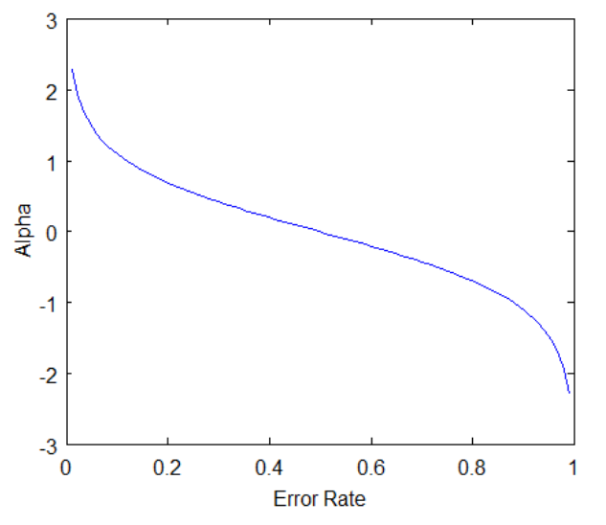
From the graph, we can see that the weights of the model grow exponentially as the error approaches zero. The weight becomes zero if the accuracy is 50% which is no better than any random guessing.

